Slide 1
CONTEMPLATIVE
PEDAGOGY
Defining and Sharing Techniques
Notes:
Note title
Type your notes here. They will be viewable in presenter view.

Slide 2
How do you define Contemplative Pedagogy?
Defining what we mean by contemplative pedagogy can be difficult
Notes:
Note title
Type your notes here. They will be viewable in presenter view.

Slide 3
Mindfulness in the classroom, sometimes called “contemplative pedagogy” involves teaching methods designed to cultivate deepened awareness, concentration, and insight.
-Iowa State University
Notes:
Note title
Type your notes here. They will be viewable in presenter view.

Slide 4
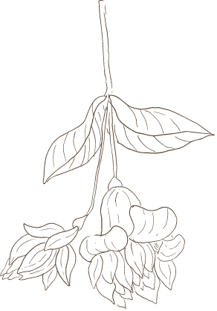
Contemplative pedagogy shifts the focus of teaching and learning to incorporate ‘first person’ approaches which connect students to their lived, embodied experience of their own learning.
- Contemplative Pedagogy Network
Notes:
Note title
Type your notes here. They will be viewable in presenter view.

Slide 5
Contemplative Pedagogy (CP) is an approach to education that uses contemplative practices, attention to the full student experience, and an interest in transformative learning to create more meaningful course environments.
-University of Massachusetts at Amherst
Notes:
Note title
Type your notes here. They will be viewable in presenter view.

Slide 6
Contemplative Pedagogy is an approach to teaching and learning with the goal of encouraging deep learning through focused attention, reflection, and heightened awareness.
- Columbia Center for Teaching and Learning
Notes:
Note title
Type your notes here. They will be viewable in presenter view.

Slide 7
Is Rooted in Mindfulness /
Contemplative Practice
Contemplative Pedagogy
An Approach to Teaching and Learning
Connected to Learning Academic Content
Notes:
Nhttps://youtu.be/jkoRR670fj8?si=tYLo17L812qwcVWP

Slide 8
The Teacher
The right kind of education begins with the educator who must understand himself and be free from established patterns of thought; for what he is, that he imparts - J. Krishnamurti
Notes:
Note title
Type your notes here. They will be viewable in presenter view.

Slide 9
The Ripple Effect
Notes:
Note title
Type your notes here. They will be viewable in presenter view.

Slide 11
Contemplative Pedagogy in the Classroom
Contemplative Writing
Mindfulness / Focused Attention
Beholding
Contemplative Reading
Notes:
Note title
Type your notes here. They will be viewable in presenter view.

Slide 12
Ok, so how do I use it in the classroom?
Sharing Ideas &
Outcomes
Notes:
https://docs.google.com/document/d/1W7d2qh1H5lyshf4902iK4io0oCFyEoIeXpQDblZKsxY/edit?usp=sharing

