Slide 1
The LaGuardia Mindfulness Corps
LaGuardia Community College (City University of New York)

Slide 2
Leaders
Paul Arcario (Former Provost)
Deema Bayrakdar (Women’s Center)
Koun Eum (Faculty, Social Science)
Ellen Quish (Director, First Year Programming)

Slide 3
Overview of LaGuardia’s Mindfulness Corps Project
Goals
Rationale
Design

Slide 4
Project Goals
To determine if engaging first-year students in accessible mindfulness practices helps them cope with potential barriers to college success.
Create a college community that engages in mindfulness practice and helps fosters a culture of caring and compassion.

Slide 5
Rationale
Community college persistence and success studies confirm that students, particularly in their transition to college, experience:
stress and anxiety
burnout
limited confidence and self-efficacy
life challenges, further exacerbated by the pandemic and issues of racial equity
These factors can distract learners and make it difficult to focus on the present.

Slide 6
Mindfulness Defined
“Mindfulness is the act of paying attention to your present-moment experience with an attitude of compassionate curiosity.”
[ Holly Rogers,“The Mindful Twenty-Something”,New Harbinger, 2016]

Slide 7
Mindfulness Helps…
Reduce stress
Boost the immune system
One cope with painful life events and negative emotions
Increase self-awareness to detect harmful reactive patterns of thought, feeling, and action
Improve attention or concentration
Enhance positive emotions
Increase interpersonal skills
Reduce addictive behaviors
Enhance performance, whether in work, sports, or academics
[UCLA Mindful Awareness Research Center]

Slide 8
Benefits:
For students at Duke University, ten minutes a day of mindfulness practice for four weeks had a significant impact on our students’ lives, helping them sleep better, feel less stressed, be more mindful, and have greater self-compassion.
- Greeson et al, 2014

Slide 9
Benefits:
Researchers at the University of Oregon found that students’ conflict attention (ability to continue to attend to something in the face of intruding or distracting information) improved significantly in just twenty minutes of meditation practice a day for five days.
-Smalley and Winston, Fully Present: The Science, Art, and Practice of Mindfulness, Da Capo Press, 2010

Slide 10
Project Design
Supported by a two-year grant from the Completion Innovation Fund grant, the LaGuardia Mindfulness Corps Project:
Launched its pilot in Fall 2022
Offers a semester-long professional development seminar for First Year Seminar (FYS) faculty. Yr 2 is including other classes besides FYS
Supports sustained mindfulness practice for participating faculty, Student Success Mentors, and students
Uses UCLA Mindful Awareness Research Center (MARC) free Mindful App
Builds off of support from MARC Director of Mindfulness Education
Develops a peer community of mindfulness practice
Assesses the impact of mindfulness practice on first-year students

Slide 11
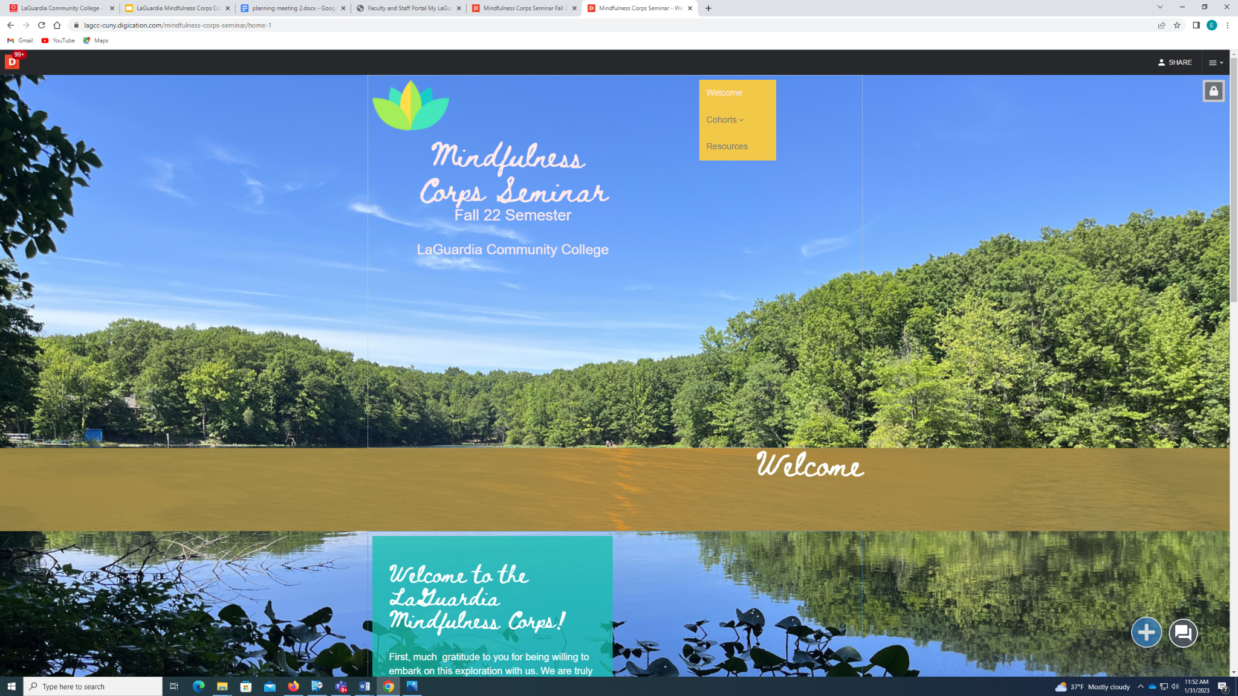
LaGuardia Mindfulness Corps Professional Development Seminar

Slide 12
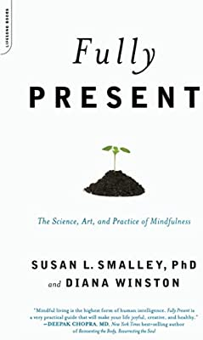
LaGuardia Mindfulness Corps Professional Development Seminar
Highlights:
Five-session seminar for participating faculty
Resources include the book Smalley and Winston, “Fully Present: The Science, Art, and Practice of Mindfulness” (Da Capo Press, 2010) and the UCLA Mindful App
Benefits and practice of mindfulness meditation are introduced
ePortfolio is used as a space for reflection and application of seminar content
Student Success Mentors participate as availability allows
Invited students share their experiences

Slide 13
LaGuardia Mindfulness Corps Professional Development Seminar
Topics:
Introduction to mindfulness
Relational mindfulness
The UCLA Mindful App as an accessible resource to support mindfulness practice
Establishing a student-friendly rationale for mindfulness practice
Developing a plan for integrating and supporting mindfulness practice in your FYS
Addressing student resistance to mindfulness practice

